Slide 1
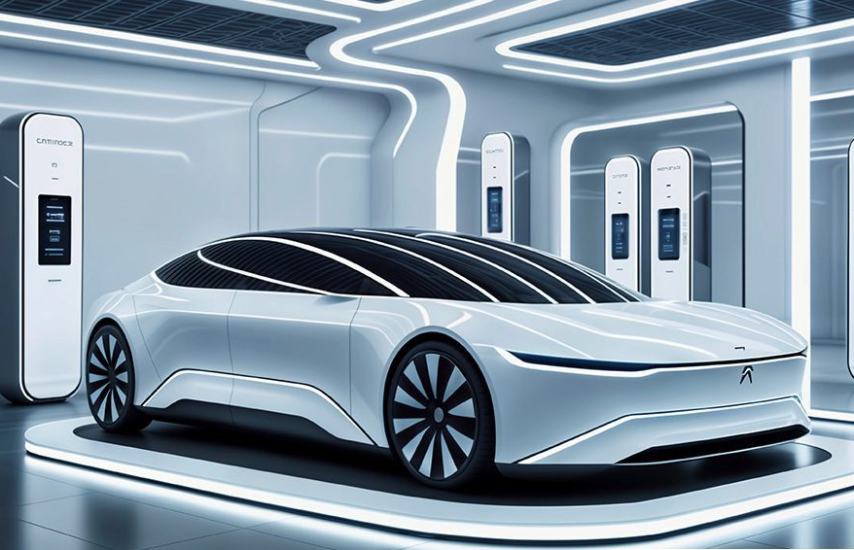
Optimizing EV Charging Infrastructure: A Data-Driven Approach for Washington
Juan Carpio
DA13 Cohort
Nashville Software School
March 2025

Slide 2



Objective: Design a strategy for efficient EV charging station distribution.
Approach: Analyze public data and maps visualization. Geographic location (latitude/longitude) Number of registered EVs Number of charging stations and chargers
Challenges: Data integration, effective modeling, and clear visualization.

Slide 3
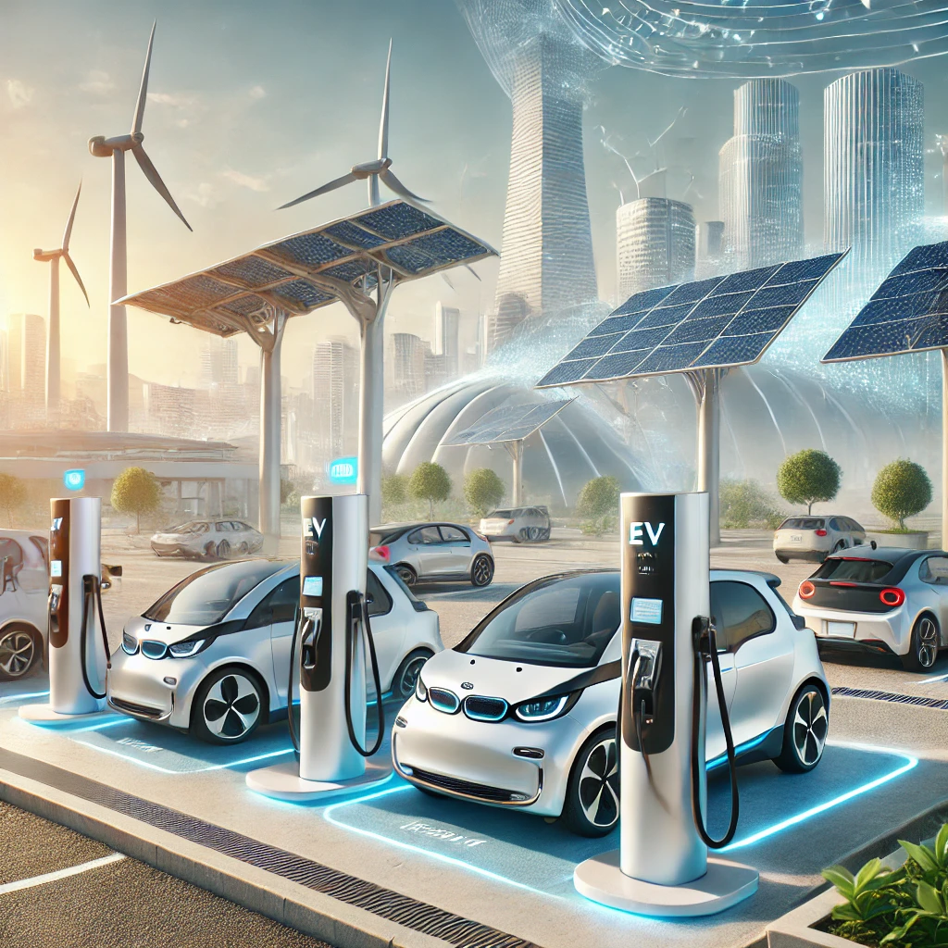
Methodology
Data Collection
Public datasets: Washington Department of Transportation, EV registration records, and charging station databases.
Tools: Python for modeling and heat maps (Folium for mapping), Power BI for data visualization and Excel for data cleaning.
Data Cleaning & Preparation
Standardizing formats, handling missing values, and filtering relevant data using Excel.
Geographic alignment of charging stations and EV density.
Exploratory Data Analysis (EDA)
Identifying correlations between EV population, charging station distribution, and traffic patterns.
Detecting underserved areas through heatmaps and clustering techniques using Folium.

Slide 4
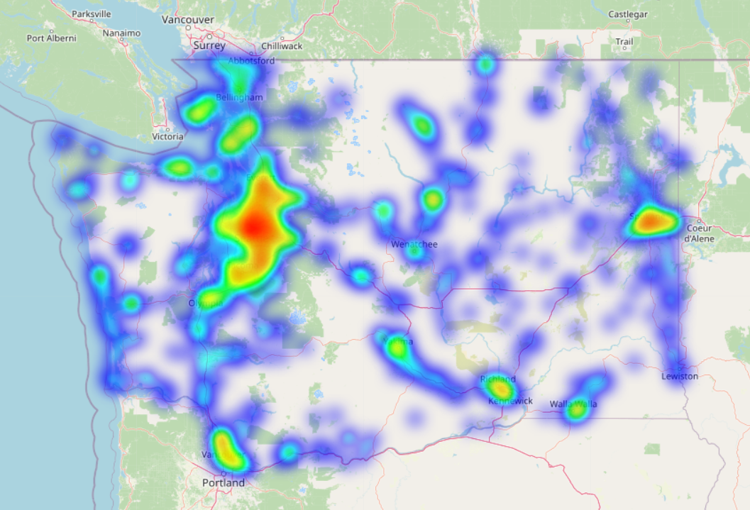
Problem Overview The increasing adoption of electric vehicles (EVs) in Washington presents both opportunities and challenges for infrastructure planning. While EVs contribute to reducing carbon emissions and reliance on fossil fuels, their widespread adoption is hindered by limitations in charging infrastructure.
Uneven Distribution of Charging Stations.
Infrastructure Deficit in High-Growth Areas.
Challenges in Strategic Station Placement.
Need for Data-Driven Decision-Making.
Goal This analysis aims to provide insights for policymakers, urban planners, and businesses investing in EV infrastructure.

Slide 5
Information Table
Charger Type | Current Type | Voltage | Power Output | Charging Time | Common Connectors by Region | Best Use Case
Level 1 (Slow Charging) | AC (Alternating Current) | 120V (North America), 230V (Europe & others) | 1 - 1.9 kW | 8 - 20 hours | North America: J1772 / Europe: Type 2 (Mennekes) / Asia: Type 1 or Type 2 | Home charging, overnight charging
Level 2 (Medium Charging) | AC | 208V-240V (North America), 230V-400V (Europe) | 3.3 - 22 kW | 4 - 8 hours | North America: J1772 / Europe: Type 2 / China: GB/T / Japan: Type 1 | Home charging, workplace, public slow chargers
Level 3 (DC Fast Charging) | DC (Direct Current) | 400V - 1000V | 50 kW - 350 kW | 20 - 60 minutes | North America: CCS1, Tesla (NACS) Supercharger / Europe: CCS2, CHAdeMO / China: GB/T / Japan: CHAdeMO | Highway charging, long trips, fleet charging
Ultra-Fast Charging | DC | 800V - 1000V+ | 350 kW+ | Less than 20 minutes | Tesla Supercharger V3, Ionity (Europe), Electrify America | High-performance EVs, ultra-fast road trip stops

Slide 6

General Data

Slide 8
What are the key factors for optimizing the distribution of EV charging stations in Washington?

Slide 9
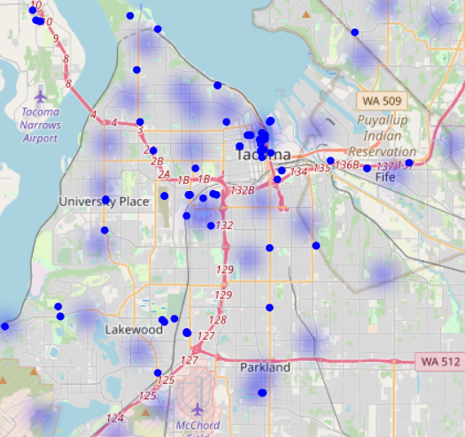
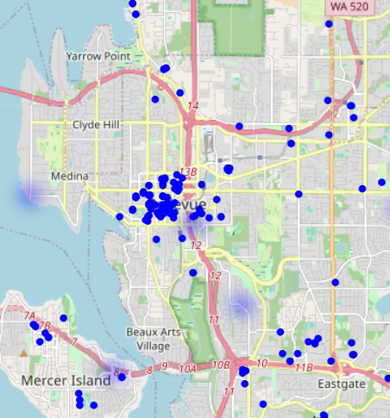
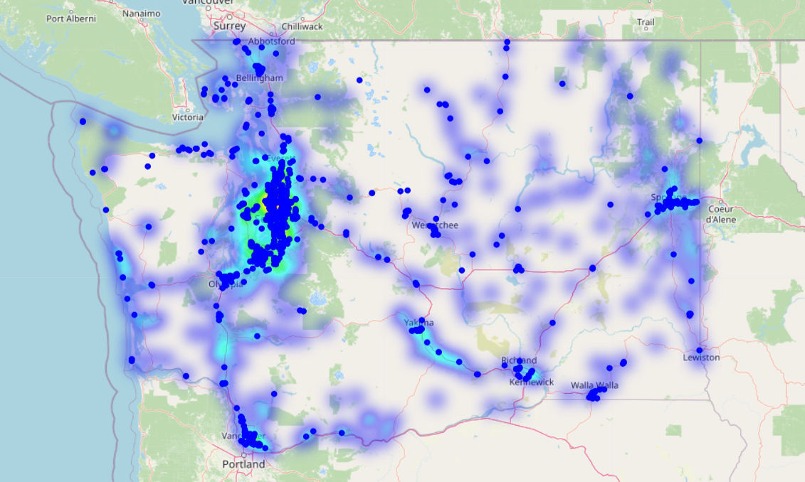
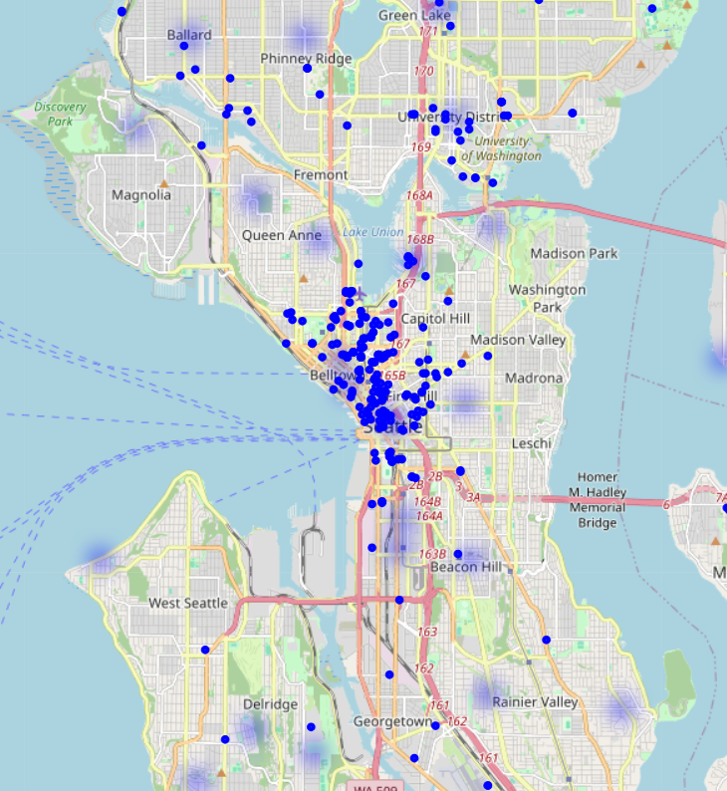
• Which cities in Washington have the highest concentration of EVs, and how does this correlate with the availability of charging stations?

Slide 11
• How does the distribution of EV population and chargers vary across cities in Washington?

Slide 12
• What are the optimal locations for charging stations in Washington based on traffic flow and population density?

Slide 13
Growth Rate: Percentual Change of Number of EV models by the “Year Model”

Slide 14
• How many charging stations in Washington support fast charging (EV DC Fast Count), and where are they located?

Slide 15
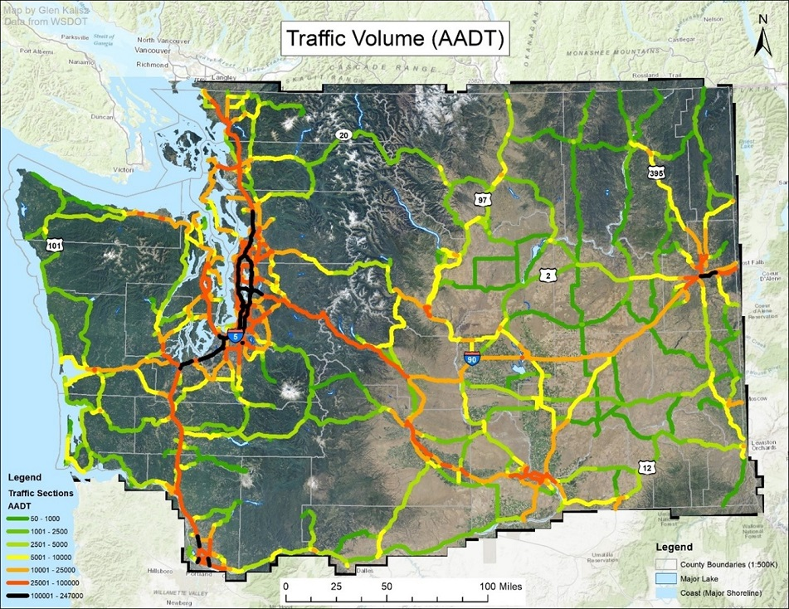
Comparison Fast Charge Stations Vs. Traffic Volume
Annual Average Daily Traffic from Washington Department of Transportation

Slide 16
Conclusions
Uneven Distribution: Urban areas have more stations, while rural and suburban zones face deficits.
High-Growth Areas Underserved: EV adoption is rising but charging infrastructure lags.
Fast Charging Gaps: Key travel corridors lack sufficient fast chargers, limiting long-distance travel.
Recommendations
Expand Infrastructure in Underserved Areas (focus on high-growth EV zones).
Increase Fast Charging Stations along highways and key travel routes.
Optimize Placement Using Data (traffic flow, EV density, demand forecasting).
Encourage Public-Private Partnerships to accelerate infrastructure growth.

Slide 17
Thank you!

Slide 18
Questions?

